Slide 1
24csp012- java programming

Slide 2
Course objective
Understand the basics of Java programming, including loops, arrays, and string manipulations.
Apply the principles of Object-Oriented Programming (OOP) such as inheritance, polymorphism, and abstraction.
Learn and implement Java Collections, Strings, and lambda expressions.
Enable students to perform file operations and utilize the Java Collection Framework.
Equip students with skills to develop GUI-based applications and connect them to databases.

Slide 3
Course OUTCOME
Co | Course Outcome | BTL
CO 1 | Apply the core principles of Java programming and Object-Oriented Programming (OOP) concepts to write modular, efficient Java applications | Ap
CO 2 | Utilize Java packages, interfaces, and exception handling mechanisms to build reusable and error-resilient code | Ap
CO 3 | Develop multi-threaded applications and perform string and wrapper class manipulations in Java. | Ap
CO 4 | Analyse input/output operations and use Java’s collection framework for real-time data storage and retrieval | An
CO 5 | Develop GUI-based Java applications using event controls and connect them to databases using JDBC | Ap

Slide 4
1.JAVA PROGRAMMING BASICS
OOP Basics – Java Features -Java Programming Concepts, Control statement, Arrays, Method Overloading, Abstract Classes, Inheritance, Method Overriding.

Slide 5

Real-World Analogy
Assembling a Personal Computer (PC)
You buy ready-made parts:
Motherboard
Processor
RAM
Hard Disk
Power Supply
You connect all parts together
You switch ON the power
The PC works as a complete system

Slide 6

Real-World Analogy
What You Do NOT Worry About
How many layers are inside the motherboard
How the hard disk is built internally
Where the RAM is manufactured
What You MUST Check
Parts are compatible
Correct interfaces are used
Supported RAM
Supported hard disk type

Slide 7

Real-World Analogy
Assembling a Car
A car is built using separate parts:
Chassis
Engine
Wheels
Brakes
Transmission
Each part has a specific function
The same type of part can be used in many cars (e.g., the same wheel model in different cars)

Slide 8


IDEA BEHIND THIS
Complex machines are built by combining parts
These parts are independent and reusable
We focus on how parts connect, not how they are made internally

Slide 9
Real-World Analogy
Hardware, such as computers and cars, are assembled from parts, which are reusable components.
Can we build software by joining random programs together?
Can we pick one routine here and another there and expect it to work?
👉 No!

Slide 10
Problem with Traditional Software Development
Unlike hardware, it is very difficult to "assemble" an application from software components.
Software components are not easily reusable
Programs are tightly coupled
Each new application is written from scratch
Existing code is hard to combine or modify

Slide 11
Reality of Software Development
Computers exist for over 60 years
Millions of programs have been written
Still, for every new application:
Code is rewritten
Logic is duplicated
Time and effort are wasted

Slide 12

REAL WORLD SCENARIO
In real life, we think in terms of objects, not steps.
Example: College System
Students
Faculty
Courses
Exams
Each has:
Data (name, ID, marks)
Actions (enroll, teach, evaluate)
👉 OOPS allows us to model software exactly the way we see the real world.

Slide 13

PROGRAMMING PARADIGMS
A style or method of programming
Defines how programs are written
Helps programmers think and solve problems
Different paradigms → different approaches
“A programming paradigm is a way of organizing and writing programs to solve computational problems.”

Slide 14
Types of Programming Paradigms
Paradigm | Key Idea | Example Languages
Procedural | Program is a sequence of steps | C
Object-Oriented | Program is built using objects | Java, C++, Python
Functional | Uses functions and immutability | Haskell
Logical | Uses rules and logic | Prolog

Slide 15

Problem with Traditional (Procedural) Programming
Data is not well protected
Programs become lengthy
Code reuse is limited
Small changes cause large errors
Difficult for team-based development
“Imagine modifying a banking program written in 10,000 lines of C code.”

Slide 16
WHY WE NEED OOPS
Software systems are becoming large and complex
Traditional programming is difficult to maintain
Real-world problems need better program structure
Industry demands reusable and secure code

Slide 17
Software Industry Uses OOPS
Most real-world applications are built using OOPS-based languages:
Java → Banking, Android apps
C++ → Games, System software
Python → AI, Web apps
C# → Enterprise applications

Slide 18
DEFINITION OF OOP
Object-Oriented Programming (OOP) is a programming paradigm that organizes software design around objects, rather than functions or logic.
An object is an instance of a class, which can contain data (attributes or properties) and methods (functions or behaviors) that operate on that data.

Slide 19
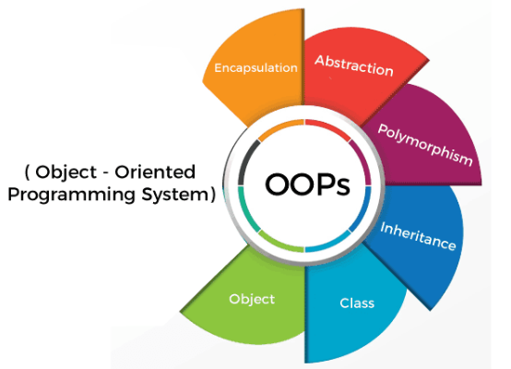
OOPS CONCEPT

Slide 20
OBJECTS
An Object can be defined as an entity that has a state and behavior, or in other words, anything that exists physically in the world is called an object.
It can represent a dog, a person, a table, etc.
In programming, it is an instance of a class.
An object means a combination of data(attributes) and methods(functions or behaviour), which further represent an entity.
Example: In a “Car” class, attributes = color, model; methods = start(), stop().

Slide 21
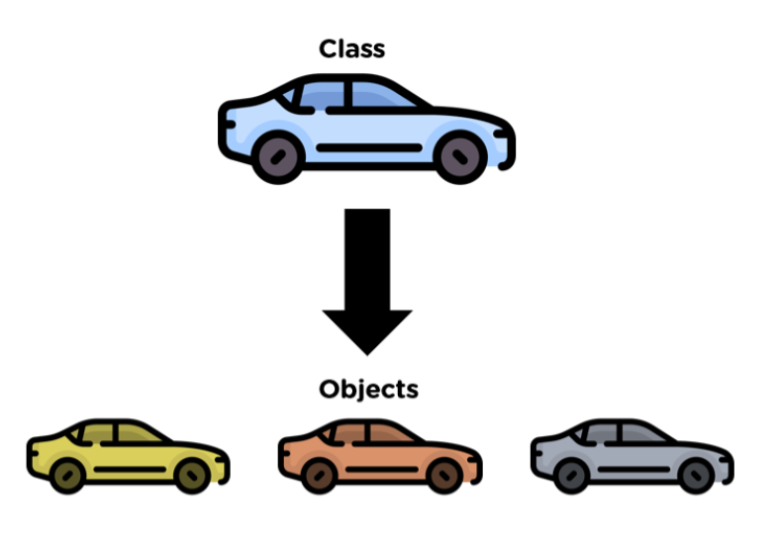
CLASS
Class can be defined as a blueprint of the object.
It is basically a collection of objects which act as building blocks.

Slide 22
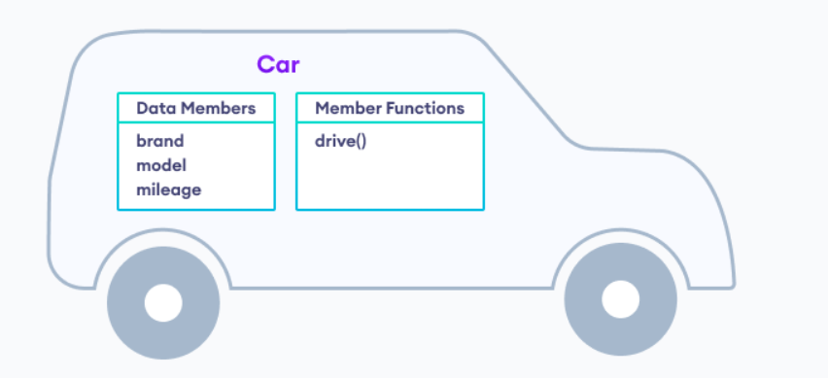
CLASS
A class contains data members (variables) and member functions.
These member functions are used to manipulate the data members inside the class.

Slide 23
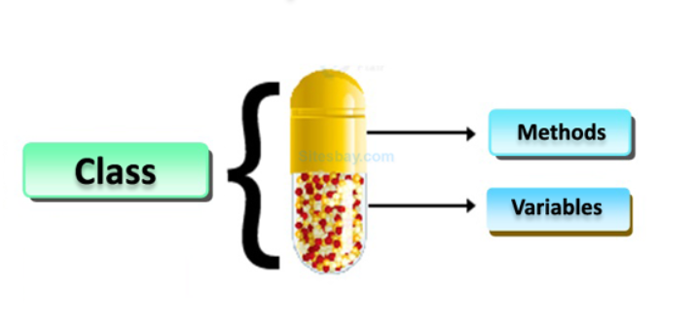
ENCAPSULATION(Data hiding)
Encapsulation means wrapping data and methods together into a single entity and restricting direct access to the data from outside the class.

Slide 24
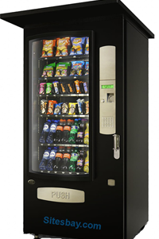
Real Life Example of Encapsulation in C++
Automatic Cola Vending Machine :
Suppose you go to an automatic cola vending machine and request for a cola.
The machine processes your request and gives the cola.
Here automatic cola vending machine is a class.
It contains both data i.e. Cola can and operations i.e. service mechanism and they are wrapped/integrated under a single unit Cola Vending Machine.

Slide 25
REAL WORLD ANALOGY
A Washing Machine and It's Power Button: What is the function that power button does? Switches the machine on (obviously).
But did u ever imagined the inside mechanism.
Doesn't matter unless it's functioning well. That's encapsulation.
The object is wrapped and inner details are hidden.
Only thing is that object can be called and used. User friendly!

Slide 26
Data abstraction
Abstraction is the concept of exposing only the required essential characteristics and behavior with respect to a context.
Hiding of data is known as data abstraction. In object oriented programming language this is implemented automatically while writing the code in the form of class and object.
Abstraction is one of the feature of Object Oriented Programming, where you show only relevant details to the user and hide irrelevant details.

Slide 27
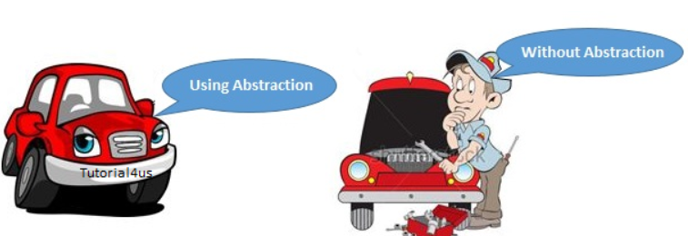
REAL WORLD ANALOGY
Consider a real life example of a man driving a car.
The man only knows that pressing the accelerators will increase the speed of car or applying brakes will stop the car but he does not know about how on pressing accelerator the speed is actually increasing, he does not know about the inner mechanism of the car or the implementation of accelerator, brakes etc in the car.

Slide 28
POLYMORPHISM
The process of representing one Form in multiple forms is known as Polymorphism.
Here one form represent original form or original method always resides in base class and multiple forms represents overridden method which resides in derived classes.

Slide 29
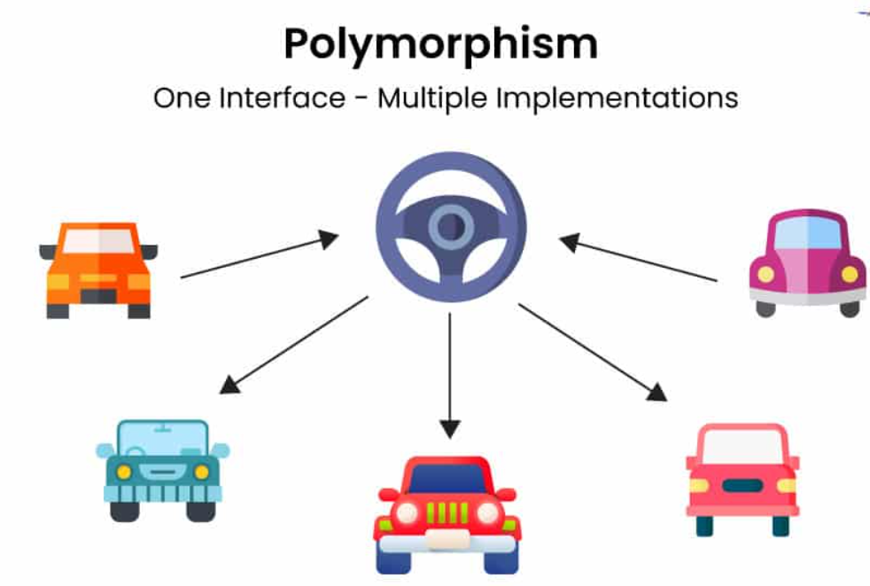
POLYMORPHISM

Slide 30
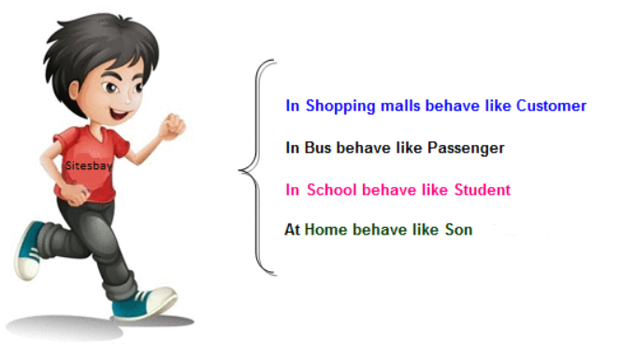
REAL WORLD ANALOGY
Suppose if you are in class room that time you behave like a student, when you are in market at that time you behave like a customer, when you at your home at that time you behave like a son or daughter, Here one person present in different-different behaviors.

Slide 31

REAL WORLD ANALOGY
You can see in the Image, Man is only one, but he takes multiple roles like - he is a dad to his child, he is an employee, a salesperson and many more.
This is known as Polymorphism.

Slide 32
INHERITANCE
The process of obtaining the data members and methods from one class to another class is known as inheritance.
In the inheritance the class which give data members and methods is known as base or super or parent class.
The class which is taking the data members and methods is known as sub or derived or child class.

Slide 33
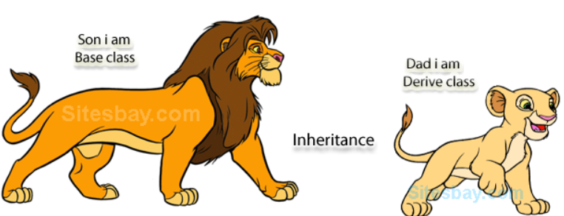
REAL WORLD ANALOGY
The real life example of inheritance is child and parents, all the properties of father are inherited by his son.

Slide 34
Introduction to java
Java is a general-purpose, object-oriented programming language.
Developed for distributed systems and consumer electronic devices.
Platform-independent: supports Write Once, Run Anywhere (WORA).
Runs on multiple operating systems like Windows, Linux, Solaris, etc.
Concurrent, class-based, and object-oriented.
Free, simple, and easy to learn.

Slide 35
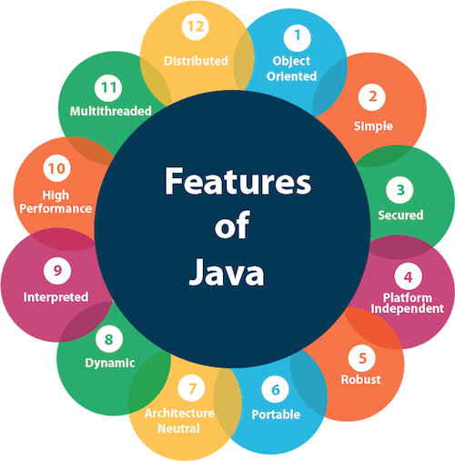
JAVA FEATURES

Slide 36
Object oriented
Java is an object-oriented programming language.
Everything in Java is associated with classes and objects.It supports
Encapsulation – Binding data and methods together
Inheritance – Reusing code by deriving new classes
Polymorphism – One interface, multiple implementations
Abstraction – Hiding implementation details
This improves code reusability, flexibility, and maintainability.

Slide 37
SIMPLE
Java is designed to be easy to learn and use.
It eliminates complex features found in languages like C++, such as pointers, multiple inheritance using classes, and operator overloading.
Java syntax is clean and readable, making program development easier and less error-prone.
It has Rich set of API .
It has Garbage Collector which is always used to collect un-Referenced (unused) Memory location for improving performance of a Java program.
It contains user friendly syntax for developing any applications.

Slide 38
secure
It is a more secure language compared to other language.
In this language, all code is covered in byte code after compilation which is not readable by human.
Java provides a high level of security by:Not using explicit pointers
The Java Runtime Environment(JRE) has a classloader that dynamically loads the classes into the Java Virtual Machine.
Providing access control through public, private, and protected keywords. The Security Manager of Java decides what resources to allot to a class includes reading & writing.
Running programs inside a sandbox environment

Slide 39
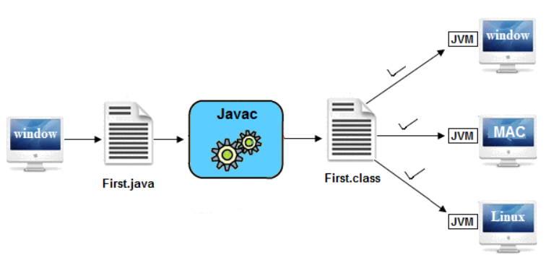
PLATFORM INDEPENDENT
Java is a platform-independent language as the source code of Java can run on multiple operating systems.
Java programs can run on any machine or the operating system that does not need any special software installed.
Although the JVM needs to be present in the machine.
Java code compiles into bytecode(.class file), which is platform-independent. We can run this bytecode on Windows, Linux, Mac OS, etc.
Hence, Java follows the principle “Write Once, Run Anywhere (WORA)”.

Slide 40
ROBUST
Java is robust due to:
Strong memory management
Automatic garbage collection
Exception handling mechanism
Compile-time and runtime error checking
These features help in building reliable and error-free applications

Slide 41
PORTABLE
Java is portable because Java code is executable on all the major platforms. for each platform.
Once we compile Java source code to bytecode, we can use it in any Java-supported platform without modification, unlike other languages that require compiling the code
Java is portable because we can carry bytecode over to any other platform it runs on.

Slide 42
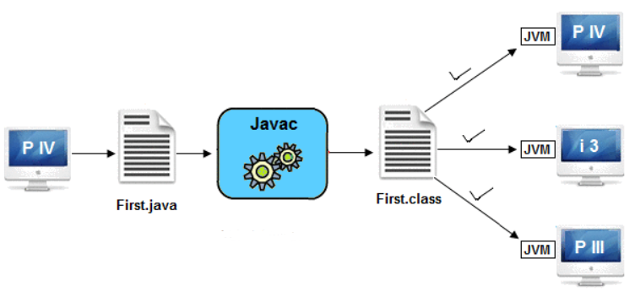
ARCHITECTURE NEUTRAL
A Language or Technology is said to be Architectural neutral which can run on any available processors in the real world without considering their development and compilation.

Slide 43
DYNAMIC
Java supports dynamic loading of classes at runtime.
Programs can load new classes, libraries, and methods without restarting the application, making Java flexible and extensible.
The process of allocating the memory space to the input of the program at a run-time is known as dynamic memory allocation.
In programming,to allocate memory space dynamically we use an operator called 'new' 'new' operator which is known as dynamic memory allocation operator.

Slide 44
INTERPRETED
Java is called an interpreted language because its compiled code (bytecode) is executed by the Java Virtual Machine (JVM) rather than directly by the hardware..
After compilation, the Java interpreter in the JVM reads the bytecode line by line and converts it into machine-specific instructions at runtime.
This interpretation process allows Java programs to run on different platforms without modification.

Slide 45
HIGH PERFORMANCE
Although Java is interpreted, it uses the Just-In-Time (JIT) compiler, which converts bytecode into native machine code at runtime. This significantly improves execution speed and performance.
It have high performance because of following reasons:
This language uses Bytecode which is faster than ordinary pointer code so Performance of this language is high.
Garbage collector, collect the unused memory space and improve the performance of the application.
It has no pointers so that using this language we can develop an application very easily.
It support multithreading, so time consuming process can be reduced to execute the program.

Slide 46
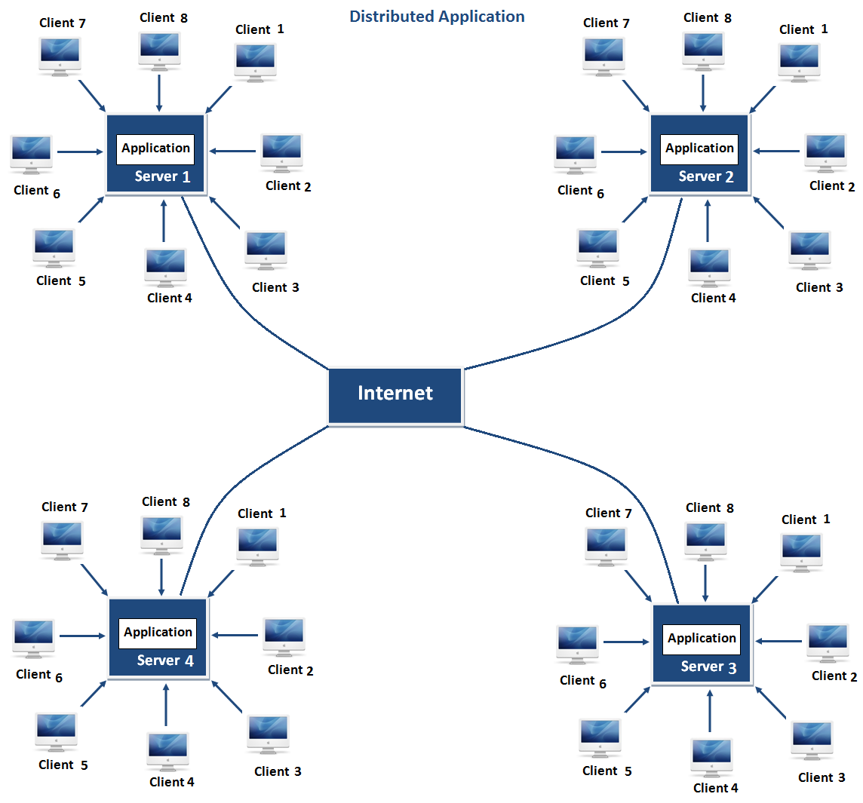
DISTRIBUTED
Java supports distributed application development using:
Remote Method Invocation (RMI)
Networking APIs
Web services
This allows Java programs to communicate over networks effectively.
In distributed application multiple client system depends on multiple server systems so that even problem occurred in one server will never be reflected on any client system.

Slide 47
MULTI THREADED
Java supports multithreading, allowing multiple tasks to run simultaneously within a program.
This improves CPU utilization and application performance, especially in real-time and interactive applications like games and web servers.

Slide 48
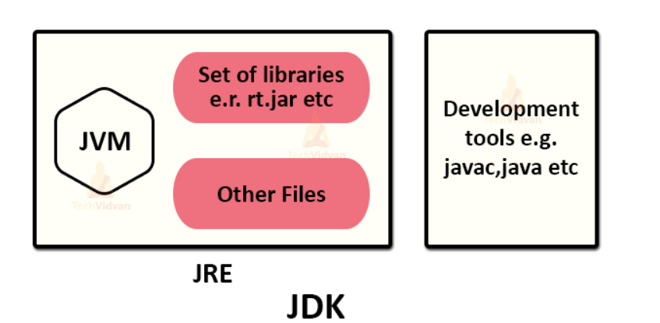
Java Architecture – Java Environment
Architecture of Java and its main components like JRE, JVM, and JDK.
These components together help you to build Java programs.

Slide 49
JVM (Java Virtual Machine)
Java Virtual Machine(JVM) provides a runtime environment in which bytecode executes.
Java Virtual Machine is platform-dependent.
The JVM performs the following tasks:
Loading the code
Verifying the code
Executing the code
Providing a runtime environment

Slide 50
JRE (Java Runtime Environment)
JRE is a collection of tools that allow the development of applications and provide a runtime environment to run Java programs.
JVM is a part of JRE.
JRE is also platform-dependent.
JRE facilitates the execution of Java programs and comprises JVM, Runtime class libraries, User interface toolkits, Deployment technologies, Java plugin, etc.

Slide 51
JDK (Java Development Kit)
Java Development Kit is a kit that provides the environment to develop and execute a Java program.
JDK includes development tools to provide an environment to develop Java programs.
It also contains JRE that runs your Java code.
JDK also contains other resources like the interpreter/loader, compiler (javac), an archiver (jar), and a documentation generator (Javadoc).

Slide 52
JAVA PROGRAMMING CONCEPTS
DATATYPES
VARIABLES
KEYWORDS
CONSTANT

Slide 53
IDENTIFIERS
Identifiers are the names given to program elements such as variables, methods, classes, objects, and packages.
They are used to identify and access these elements in a Java program.

Slide 54
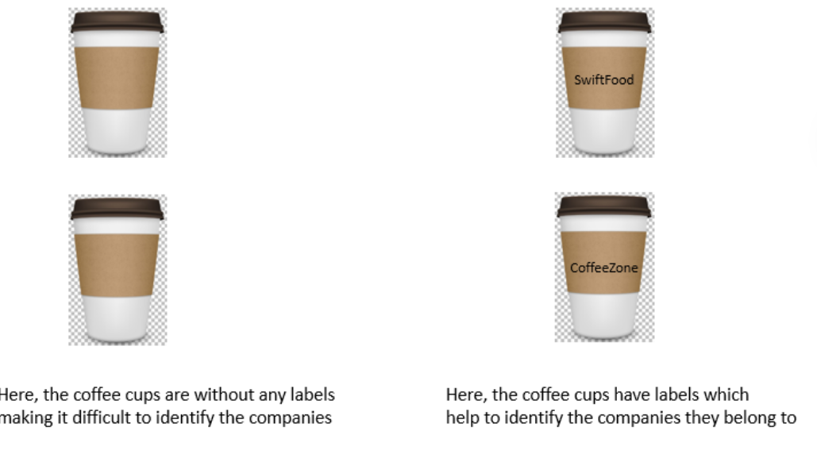
IDENTIFIERS

Slide 55
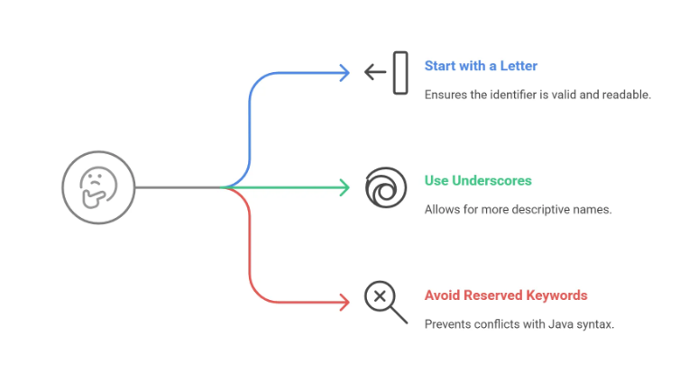
Rules for Identifiers in Java
Rules for Identifiers in Java
Can contain letters (A–Z, a–z), digits (0–9), underscore (_), and dollar sign ($)
Must start with a letter, underscore (_), or dollar sign ($)
Cannot start with a digit
No spaces allowed
Cannot be a Java keyword (e.g., int, class, public)
Case-sensitive (Total and total are different)

Slide 56
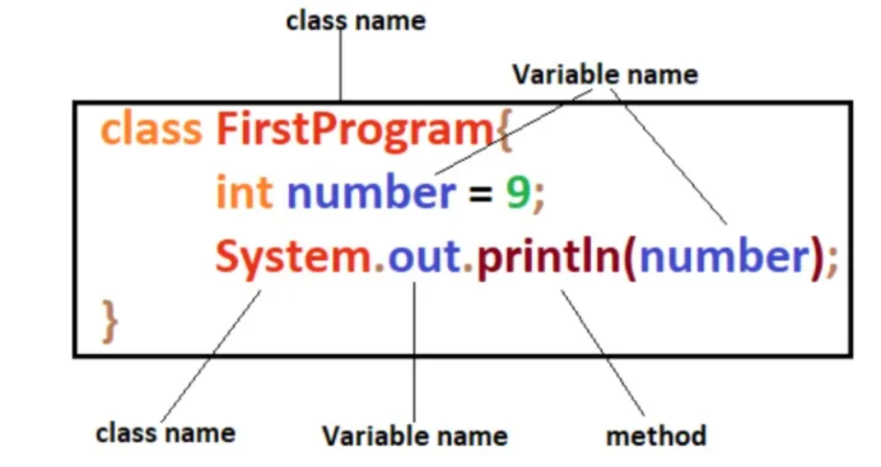
identifiers definition and their roles

Slide 57
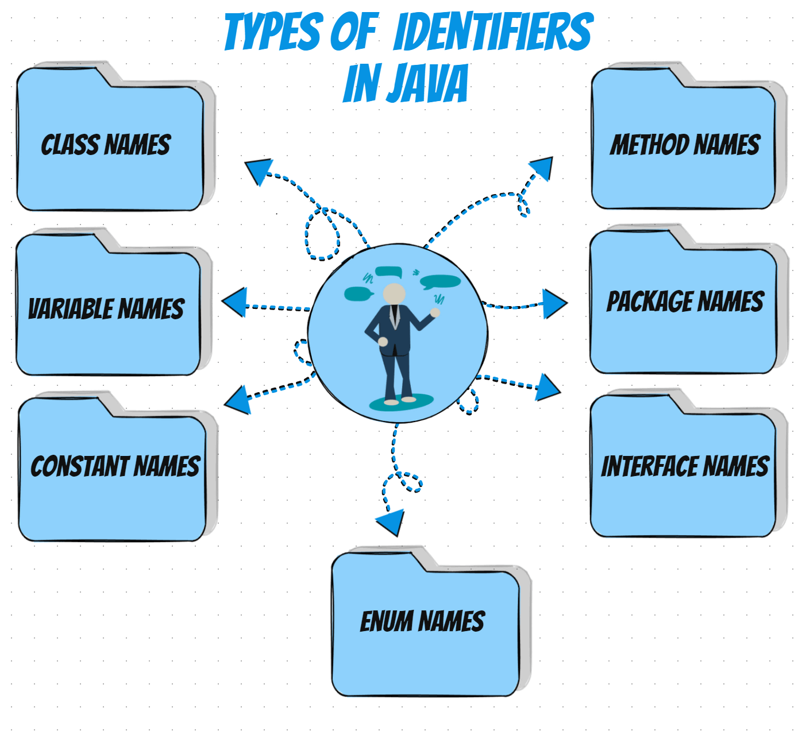
TYPES OF IDENTIFIERS

Slide 58
TYPES OF IDENTIFIERS
Classes: Identify and differentiate logical program units. Example: Person, EmployeeDetails.
Methods: Name operations for clarity. Example: calculateSalary, printDetails.
Variables: Represent data with meaningful names. Example: age, totalAmount.
Constants: Define fixed values. Example: MAX_LIMIT, PI.

Slide 59
VALID VS INVALID IDENTIFIERS
VALID IDENTIFIERS | INVALID IDENTIFIERS
MyVar a myvar MYVAR j _myvar $myvar series_of_numbers techvidvan123 | DATA-REC contains special character – (other than A-Z, a-z, and _ or $) 98MyVar Starting with a digit break reserved keyword My.file contains special character

Slide 60
VARIABLES
A variable is a named memory location used to store data whose value can change during program execution.
Syntax:
dataType variableName = value;
Example:
int count = 10;
float marks = 85.5f;
char grade = 'A';

Slide 61
Types of Variables Local Variables
Declared inside a method, constructor, or block
Accessible only within that block
No default value
void display()
{
int x = 5; // local variable
}

Slide 62
Instance Variables
Declared inside a class but outside methods
Each object gets its own copy
Default values are assigned automatically
class Student
{
int rollNo; // instance variable
}

Slide 63
Static Variables
Static Variables
Declared using the static keyword
Shared among all objects of a class
Memory allocated only once
class Student
{
static String collegeName = "ABC College";
}

Slide 64
NAMING CONVENTIONS
Variable names should start with a lowercase letter
Use camelCase style(studentName, calculateSum())
Names should be meaningful and descriptive
Avoid single-letter names (except for loop counters like i, j)
Do not use spaces
Do not use Java keywords
Variable names are case sensitive(var,Var is two different varibles)

Slide 65
CONSTANTS
A constant is a variable whose value cannot be changed once assigned.
To declare a constant use final keyword.
Characteristics of Constants
Value is fixed
Reassignment causes compile-time error
Improves readability and safety
final int MAX = 100;
final float PI = 3.14f;

Slide 66
Naming Convention for Constants
Written in UPPERCASE letters
Words separated using underscore (_)
final int MAX_MARKS = 100;

Slide 67
VARIABLES VS CONSTANTS
Aspect | Variables | Constants
Value change | Can change | Cannot change
Keyword | No keyword required | final keyword used
Flexibility | More flexible | Fixed and secure
Example | int count = 5; | final int MAX = 10;

Slide 68
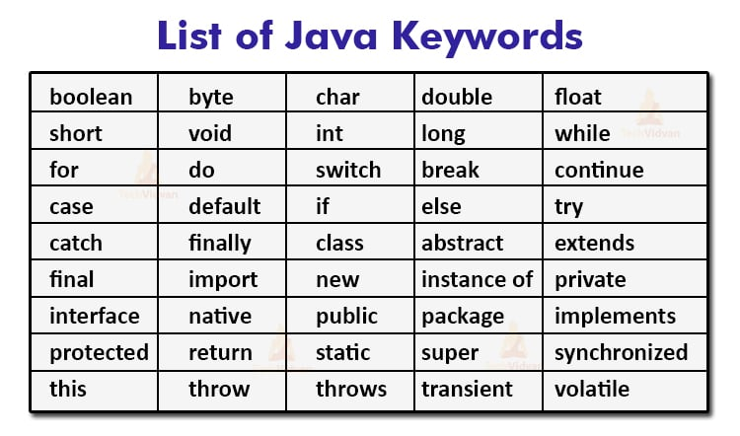
KEYWORDS
Keywords are reserved words in Java that have a predefined meaning and cannot be used as identifiers (variable names, method names, class names, etc.).

Slide 69
Commonly Used Java Keywords (Category-wise)
1. Data Type Keywords
int, float, double, char, boolean, void
2. Access Modifiers
public, private, protected
3. Class & Object Keywords
class, new, this, super, static, final
4. Control Statements
if, else, switch, case, for, while, do, break, continue, return
5. Exception Handling
try, catch, finally, throw, throws
6. Inheritance & Abstraction
extends, implements, abstract, interface

Slide 70
DATATYPES
Datatype
Primitive
Non primitive
A data type in programming is a way to define what kind of data a variable can hold and how much memory it will use.
Variables of Primitve data types hold the value of the data item.
Variables of Non Primitve data types hold the reference of the memory location where the data object is stored.

Slide 71
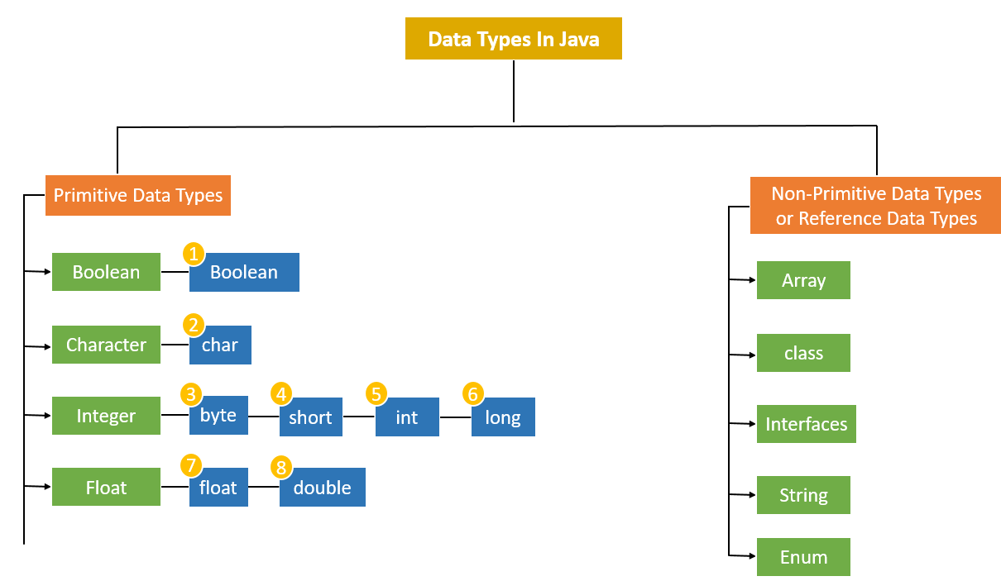
DATATYPES

Slide 72
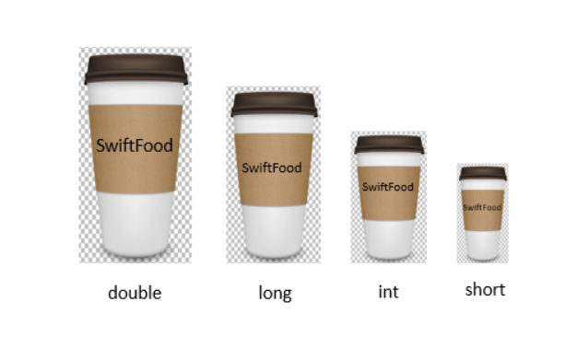
Data Types
Consider the example of coffee shop. You might have ordered different types of coffee like Caramel Frappuccino Mini, Caffe Latte Tall, Caffe Mocha Grande, etc. Just like how we have different sizes of coffee cups like mini, tall, grande etc., in Java, primitive data types have different sizes.

Slide 73
Primitive data types
Data Type | Size | Default Value | Description / Example | Format Specifier
byte | 1 byte | 0 | Small integers (-128 to 127) | %d
short | 2 bytes | 0 | Medium integers (-32,768 to 32,767) | %d
int | 4 bytes | 0 | Standard integers (-2³¹ to 2³¹-1) | %d
long | 8 bytes | 0L | Large integers (-2⁶³ to 2⁶³-1) | %d or %ld
float | 4 bytes | 0.0f | Decimal numbers (single precision) | %f
double | 8 bytes | 0.0d | Decimal numbers (double precision) | %f
char | 2 bytes | '\u0000' | Single Unicode character ('a', '1') | %c
boolean | 1 bit | false | True or False (true/false) | %b

Slide 74
IMPORTANT POINTS
Numeric and boolean (true, false) values are written without quotes. E.g. int score = 85; boolean isQualified = true;
The character value must be written in single quotes while assigning it to a character variable. E.g. char gender = 'M';
A long value is assigned to the variable, suffixed with L (uppercase letter or lower case letter L can be used). E.g. long salary = 500000L;
A float value must be suffixed with F or f while assigning to the variable. E.g. float average = 78.6f;
Default values are not applicable to the variables declared inside a method. The variables declared inside a method must be initialized with a value before printing their value or performing any operation on them.

Slide 75
EXAMPLE
class Demo
{
public static void main(String[] args)
{
int quantity;
float totalCost = 10 * quantity; // error on this line
System.out.println(totalCost);
}
}

Slide 76
CODING STANDARDS
In Java, variable names should be nouns starting with lowercase letter. If it contains multiple words, then every inner word must start with capital letter. This type of casing is called camel casing.
Some examples of variables are given below:
mobileNumber
name
unitPrice
paymentMode
age

Slide 77
CODING STANDARDS
Comments are those statements which are not executed by the compiler. Comments can be used to provide information about a variables or statement.
There are two types of comments in Java:
Single line comment
It is used to comment only one line
//This is a single line comment

Slide 78
CODING STANDARDS
Multi-line comment
It is used to comment multiple lines of code
public static void main(String args[]) {
/*
Given below is a variable age
and a print statement to print age
*/
int age = 25;
System.out.println(age);
}

Slide 79
OPERATORS
An operator in Java is a symbol that is used to perform specific operations.
Operators are the constructs that can manipulate the values of the operands.
Consider the expression 2 + 3 = 5, here 2 and 3 are operands and + is called operator.

Slide 80
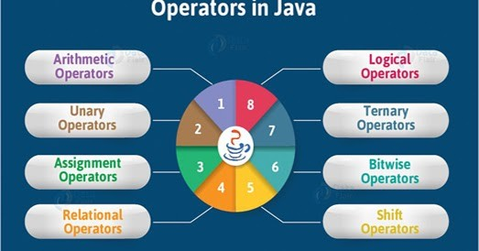
OPERATORS

Slide 81
ARITHMETIC OPERATORS
Used for mathematical calculations:
Operator | Description | Example | Result
+ | Addition | 5 + 3 | 8
- | Subtraction | 5 - 3 | 2
* | Multiplication | 5 * 3 | 15
/ | Division | 10 / 2 | 5
% | Modulus (remainder) | 10 % 3 | 1
++ | Increment | i++ | i = i+1
-- | Decrement | i-- | i = i-1

Slide 82
EXAMPLE
public static void main(String args[])
{
int numOne = 10;
int numTwo = 5;
System.out.println(numOne + numTwo); //Output will be 15
System.out.println(numOne - numTwo); //Output will be 5
System.out.println(numOne * numTwo); //Output will be 50
System.out.println(numOne / numTwo); //Output will be 2
System.out.println(numOne % numTwo); //Output will be 0
}

Slide 83
Relational Operators
Used to compare two values, result is boolean (true/false):
Operator | Description | Example | Result
== | Equal to | 5 == 3 | false
!= | Not equal to | 5 != 3 | true
> | Greater than | 5 > 3 | true
< | Less than | 5 < 3 | false
>= | Greater or equal | 5 >= 5 | true
<= | Less or equal | 5 <= 3 | false

Slide 84
EXAMPLE
public static void main(String args[])
{
int numOne = 10;
int numTwo = 5;
System.out.println(numOne > numTwo); //Output will be true
}

Slide 85
Logical Operators
Used to combine boolean expressions:
Operator | Description | Example | Result
&& | Logical AND | (true && false) | false
` |  | ` | Logical OR
! | Logical NOT | !true | false

Slide 86
EXAMPLE
public static void main(String args[])
{
int numOne = 100;
int numTwo = 20;
int numThree = 30;
System.out.println(numOne > numTwo && numOne > numThree); //Output will be true
}

Slide 87
Assignment Operators
Used to assign values to variables:
Operator | Example | Meaning
= | x = 5 | Assign 5 to x
+= | x += 3 | x = x + 3
-= | x -= 3 | x = x - 3
*= | x *= 3 | x = x * 3
/= | x /= 3 | x = x / 3
%= | x %= 3 | x = x % 3

Slide 88
EXAMPLE
public static void main(String args[]) {
int numOne = 10; //The value 10 is assigned to numOne
System.out.println(numOne); //Output will be 10
numOne += 5;
System.out.println(numOne); //Output will be 15
numOne -= 5;
System.out.println(numOne); //Output will be 10
numOne *= 5;
System.out.println(numOne); //Output will be 50
numOne /= 5;
System.out.println(numOne); //Output will be 10
}

Slide 89
Unary Operators
Operate on one operand:
Unary Operator | Description | Example | Result / Effect
+ | Unary plus (indicates positive value) | +a | Value of a remains the same
- | Unary minus (negates the value) | -a | Value of a becomes -a
++ (prefix) | Increment by 1 before use | ++a | Increases a by 1, then uses it
++ (postfix) | Increment by 1 after use | a++ | Uses a first, then increases by 1
-- (prefix) | Decrement by 1 before use | --a | Decreases a by 1, then uses it
-- (postfix) | Decrement by 1 after use | a-- | Uses a first, then decreases by 1
! | Logical NOT (reverses boolean value) | !true | false

Slide 90
EXAMPLE
public static void main(String args[])
{
int numOne = 10;
int numTwo = 5;
boolean isTrue = true;
System.out.println(numOne++ + " " + ++numOne); //Output will be 10 12
System.out.println(numTwo-- + " " + --numTwo); //Output will be 5 3
System.out.println(!isTrue + " " + ~numOne); //Output will be false -13
}

Slide 91
Ternary Operator (Conditional Operator)
Works like if else
Syntax:
(condition) ? value_if_true : value_if_false
Example:
int age = 18;
String result = (age >= 18) ? "Adult" : "Minor";

Slide 92
EXAMPLE
public static void main(String args[])
{
int numOne = 10;
int numTwo = 5;
int min = (numOne < numTwo) ? numOne : numTwo;
System.out.println(min); //Output will be 5
}

Slide 93
Bitwise Operators
Used for operations on binary numbers:
Operator | Description
& | AND
` | `
^ | XOR
~ | NOT
<< | Left shift
>> | Right shift
>>> | Unsigned right shift

Slide 94
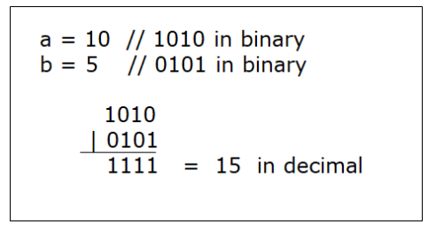
EXAMPLE
Bitwise OR(|)
It returns bit by bit OR of the input values. If either of the bits is 1, then it gives 1, else it gives 0.
E.g. - The output of 10 | 5 is 15.

Slide 95
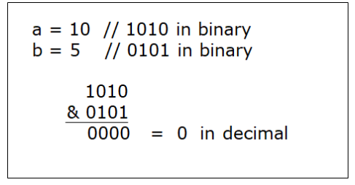
EXAMPLE
Bitwise AND(&)
It returns bit by bit AND of the input values. If both the bits are 1, then it gives 1, else it gives 0.
E.g. - The output of 10 & 5 is 0.

Slide 96
EXAMPLE
Left shift:
It takes two operators and left shifts the bits of the first operand. The second operand decides the number of places to shift. It fills 0 on voids left as a result.
E.g. - The output of 10<<1 is 20 if the numbers are stored in 32 bit system.
10 is represented as 00000000 00000000 00000000 00001010.
After left shifting by 1 bit, the result becomes 00000000 00000000 00000000 000010100 which is 20.
The 0 that is highlighted is present because of the void.
Similarly, the output of 10<<2 is 40.

Slide 97
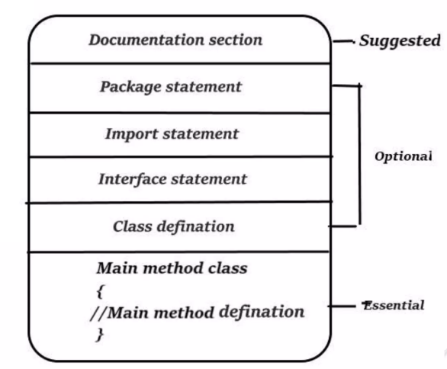
STRUCTURE OF JAVA PROGRAM

Slide 98
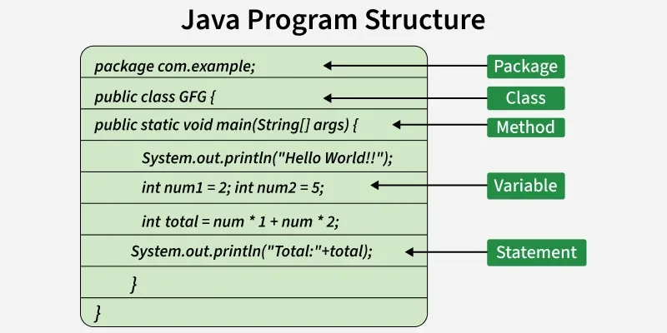
STRUCTURE OF JAVA PROGRAM

Slide 99
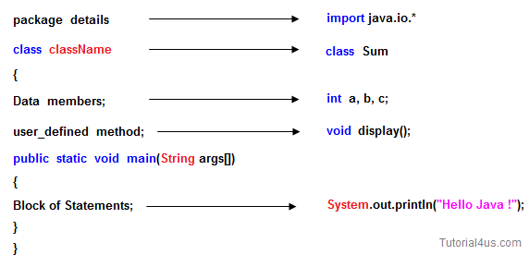
EXAMPLE

Slide 100
OUTPUT STATEMENTS
Output means displaying data on the screen.
System.out.print()
Prints text or variables without moving to a new line.
System.out.print("Hello, ");
System.out.print("World!");
OUTPUT:
Hello, World!

Slide 101
OUTPUT STATEMENTS
System.out.println()
Prints text or variables and moves to a new line after printing.
System.out.println("Hello, World!");
System.out.println("Java is fun!");
OUTPUT:
Hello, World!
Java is fun!

Slide 102
OUTPUT STATEMENTS
System.out.printf()
Used for formatted output (like C language printf).
int age = 20;
System.out.printf("My age is %d years", age);
OUTPUT:
My age is 20 years

Slide 103
Input Statements in Java
Input means taking data from the user.
Steps to use Scanner
Step 1:Import the Scanner class
Step 2:Create a Scanner object
import java.util.Scanner;
Scanner sc = new Scanner(System.in);

Slide 104
Input Statements in Java
Step 3:Use methods to take input.
nextInt() → integer input
nextDouble() → double input
next() → single word (String)
nextLine() → full line (String)

Slide 105
EXAMPLE
import java.util.Scanner;
public class InputExample
{
public static void main(String[] args)
{
Scanner sc = new Scanner(System.in);
System.out.print("Enter your name: ");
String name = sc.nextLine();
System.out.print("Enter your age: ");
int age = sc.nextInt();
System.out.println("Hello " + name + ", you are " + age + " years old.");
}
}
OUTPUT:
Enter your name: Ram
Enter your age: 21
Hello Ram, you are 21 years old.

Slide 106
Simple example using class and objects creating class
// Class definition
class Car
{
// Attributes (fields)
String color;
String model;
int year;
// Method (action)
void drive()
{
System.out.println("The car is driving.");
}
}

Slide 107
Creating and Using an Object
public class Main {
public static void main(String[] args) {
// Creating an object of Car class
Car myCar = new Car(); // myCar is an object
// Setting attributes
myCar.color = "Red";
myCar.model = "Toyota";
myCar.year = 2021;
// Using method
myCar.drive(); // Output: The car is driving.
// Printing attribute
System.out.println("My car model is " + myCar.model);
}
}
Output:
The car is driving.
My car model is Toyota

Slide 108
CLASSWORK
Problem: Write a Java program to take two numbers as input from the user, add them, and print the result.
Sample input and Output:
Enter first number: 5
Enter second number: 7
Sum of 5 and 7 is 12

Slide 109
CLASSWORK
Problem: Write a Java program to swap two numbers using a temporary variable and display the result.
Sample input and Output :
Enter first number: 10
Enter second number: 20
After swapping:
First number = 20
Second number = 10

Slide 110
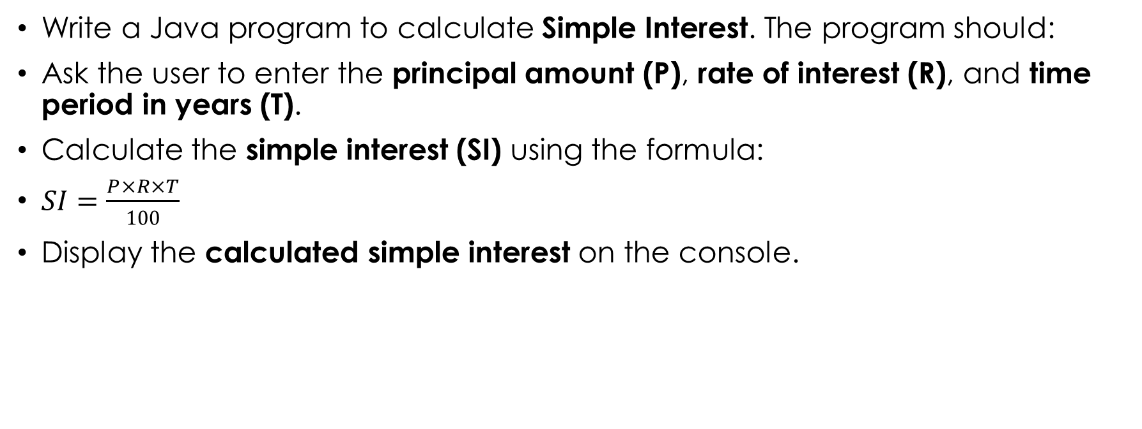
CLASSWORK
Write a Java program to calculate Simple Interest. The program should:
Ask the user to enter the principal amount (P), rate of interest (R), and time period in years (T).
Calculate the simple interest (SI) using the formula:
$SI=\frac{P×R×T}{100}$
Display the calculated simple interest on the console.

Slide 111
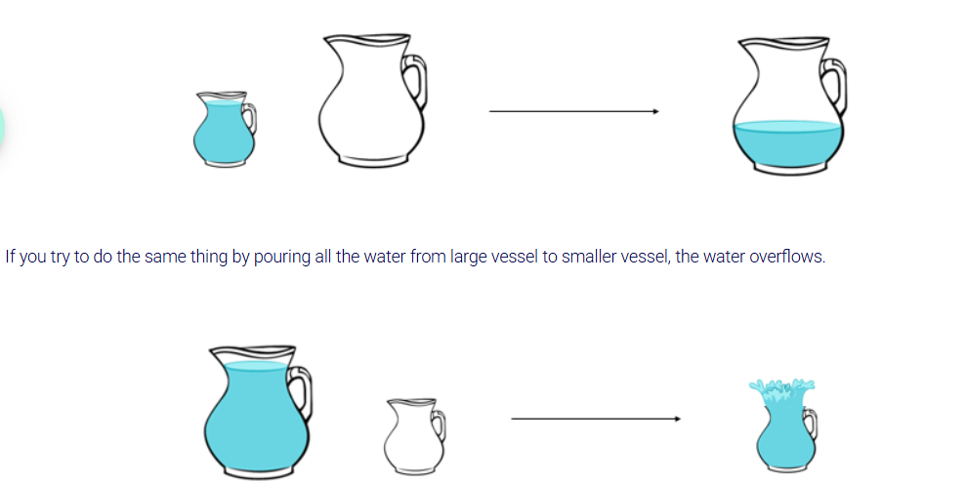
TYPE CONVERSION
Consider that you have two vessels of different sizes. If you fill the small vessel completely with water and pour this water into the large vessel, the water easily gets transferred.

Slide 112
TYPE CONVERSION
When you assign the value of one data type to another or when you perform operation on two operands, their data types must be compatible with each other. If the data types are not compatible, then the data type of an operand needs to be converted.
This conversion is of two types:
Implicit
Explicit

Slide 113
IMPLICIT CONVERSION
Implicit Type Conversion is also known as Widening conversion. It happens in the below scenarios:
When a value of a data type with smaller range is assigned to a variable of a compatible data type with larger range.
When two variables of different data types are involved in an expression, the value of smaller range datatype is converted to a value of larger range datatype and then the operation is performed.

Slide 114
EXAMPLE
When we assign the value of discountPercentage to newDiscountPercentage, automatically discountPercentage is converted to double type.
It is done automatically by the compiler; hence it is called as Implicit type conversion.
int discountPercentage = 10;
double newDiscountPercentage = discountPercentage;

Slide 115
EXPLICIT CONVERSION
Explicit Conversion is used when you want to assign a value of larger range data type to a smaller range data type.
This conversion is not done by the compiler implicitly as there can be loss of data in some cases.
Hence, programmer has to be cautious about such conversions. This is also known as Narrowing conversion.

Slide 116
EXAMPLE
This will lead to an error because a value of larger range data type, in this case double, cannot be directly assigned to a smaller range data type, in this case int. Here, you need to explicitly typecast double to int as shown below.
double totalPrice = 200;
int newPrice = totalPrice;
int newPrice = (int)totalPrice;

Slide 117
CONTROL STATEMENTS
The instructions are usually executed line by line.
Sometimes, all the statements in a program may not be executed.
There can be change in the flow of control and can be implemented using control structures.

Slide 118
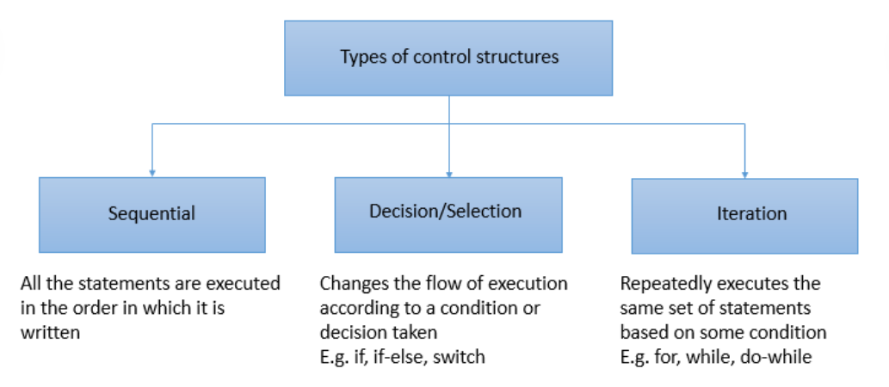
TYPES

Slide 119
IF STATEMENT
An "if" statement contains a relational and logical expression followed by a block of statements.
Based on the result of the expression, the corresponding statements/code blocks get executed or skipped
if (<condition>) { // Curly braces are not required if there is only one statement inside the block
<statements>;
}

Slide 120
EXAMPLE
While ordering food in "SwiftFood", when a customer orders food items, you need to calculate the total cost that the customer should pay for the order. The "Regular Customers" are provided with a 5% discount for their orders. Here, we are assuming that each food item costs $10. In the condition, we are checking if the customer type is "Regular". If the condition is true, the statements within the if block get executed to calculate total cost after discount.

Slide 121
EXAMPLE
public class Customer {
public static void main(String[] args) {
String customerType = "Regular";
int quantity = 2;
int unitPrice = 10;
int totalCost = 0;
int discount = 5;
totalCost = unitPrice * quantity;
if (customerType == "Regular") {
totalCost = totalCost - (totalCost * discount / 100);
System.out.println("You are a regular customer and eligible for 5% discount");
}
System.out.println("Total cost: " + totalCost);
}
}

Slide 122
IF ELSE
An if statement can be written along with an else statement.
The condition/expression given in the if statement is checked and set of statements are executed based on the outcome of the condition.
If the condition is true, the statements written in if block get executed.
If the condition is false, then the statements inside else block get executed.
if (<condition>) {
<statements>;
}
else {
<statements>;
}

Slide 123
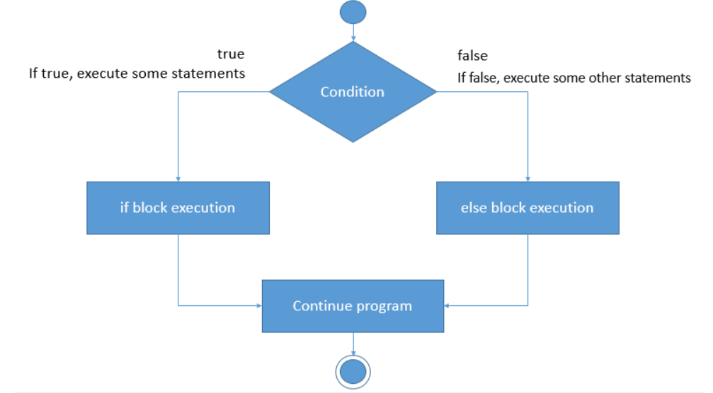
FLOW

Slide 124
EXAMPLE
In the below code, we are calculating the total cost that the customers should pay for the order. In the previous example, we considered only Regular customers. The non-regular customers have to pay an additional delivery charge of $5. So, first the customer type is checked. If the customer type is Regular, then the if block gets executed. For other types of customers, the statements of else block get executed.

Slide 125
CODE
public class Customer {
public static void main(String[] args) {
String customerType = "Regular";
int quantity = 2;
int unitPrice = 10;
int totalCost = 0;
int discount = 5;
int deliveryCharge = 5;
totalCost = unitPrice * quantity;
if (customerType == "Regular") {
totalCost = totalCost - (totalCost * discount / 100);
System.out.println("You are a regular customer and eligible for 5% discount");
}
else {
totalCost = totalCost + deliveryCharge;
System.out.println("You need to pay an additional delivery charge of $5");
}
System.out.println("Total cost: " + totalCost);
}
}

Slide 126
Else if
It is a combination of else and if.
Like else, it extends an if statement to execute a different set of statements in case the original if expression evaluates to false.
Then, the conditions present inside the else if blocks are checked.
Once a condition evaluates to true, remaining else if and else statements are skipped.
When all the conditions are false, the else block is executed.
Coding the else block is optional.

Slide 127
SYNTAX
if (<condition 1>) {
<statements>;
}
else if (<condition 2>) {
<statements>;
}
else if (<condition 3>) {
<statements>;
}
else {
<statements>;
}

Slide 128
EXAMPLE
When a customer places an order, the total cost varies according to the customer type. The customer type must be either Regular or Guest. For other values, the program should display an error message. This can be represented using if-else-if statements as shown below.

Slide 129
CODE
public class Customer
{
public static void main(String[] args)
{
String customerType = "Regular";
int quantity = 3;
int unitPrice = 10;
int discount = 5;
int deliveryCharge = 5;
int totalCost = unitPrice * quantity;
if (customerType == "Regular")
{
totalCost = totalCost - (totalCost * discount / 100);
System.out.println("You are a regular customer and eligible for 5% discount");
System.out.println("The total cost to be paid is " + totalCost);
}

Slide 130
CODE
else if (customerType == "Guest")
{
totalCost = totalCost + deliveryCharge;
System.out.println("You need to pay an additional delivery charge of $5");
System.out.println("The total cost to be paid is" + totalCost);
}
else // If there is only one statement inside a block, {} is optional
System.out.println("Invalid customer type");
}
}

Slide 131
NESTED IF
When an if statement is written within another if statement, it is known as nested if statement. It enables us to test multiple criteria.
The inner if block condition gets executed only when the condition of the outer if block evaluates to true.
if (<condition 1>) {
if (<condition 2>) {
<statements>;
}
else {
<statements>;
}
}

Slide 132
EXAMPLE
In the below code, the total cost for an order is calculated using nested if blocks. The assumption over here is that each food item costs $10. The Regular customers are provided with a 5% discount for their orders whereas the Guests need to pay an additional delivery charge of $5. First, the customer type is checked. If the customer type is Regular, then the if block gets executed. If the customer type is Guests, then else if block gets executed. Also, for regular customers, if the total cost exceeds $20, a special gift voucher will be provided to the customers. This condition is checked within the outer if block. If customer type is invalid, then the statements of else block get executed.

Slide 133
CODE
public class Customer {
public static void main(String[] args) {
String customerType = "Guest";
int quantity = 2;
int unitPrice = 10;
int totalCost = 0;
int discount = 5;
int deliveryCharge = 5;
totalCost = (unitPrice * quantity);
if (customerType == "Regular") {
totalCost = totalCost - (totalCost * discount / 100);
System.out.println("You are a regular customer and have got 5% discount");
System.out.println("The total cost to be paid is " + totalCost);
if (totalCost >= 20) {
System.out.println("You have got a gift voucher!!!!");
}
}

Slide 134
CODE
else if (customerType == "Guest")
{
totalCost = totalCost + deliveryCharge;
System.out.println("You need to pay an additional delivery charge of $5");
System.out.println("The total cost to be paid is " + totalCost);
}
else
{
System.out.println("Invalid selection");
}
}
}

Slide 135
SWITCH CASE
switch statement is also a selection control structure.
The switch statement enables to select a block from a set of options. It allows the flow of execution to be switched according to a value.
switch (expression or variable) {
case value1: <statements>;
break;
case value2: <statements>;
break;
default: <statements>;
}

Slide 136
SWITCH CASE
During execution, the result of expression or variable written in the switch statement is compared with the constant values of cases one by one.
When a match is found, the set of statements present in that case are executed until a break statement is encountered or till the end of switch block, whichever occurs first.
In the absence of break statement, the flow of control falls through subsequent cases and executes the statements of all those cases until it reaches a break statement or end of switch block.

Slide 137
SWITCH CASE
The switch block can have a special case called default. The default case is executed when none of the cases match with the value of expression/variable. default is optional. If none of the cases match and if there is no default statement, the control comes out of switch block without executing any case.
In Java, the switch block works only for the following data types:
char and integral datatypes are supported in switch-case statement, but float or double are not supported.
String datatype is also supported in switch-case statement.

Slide 138
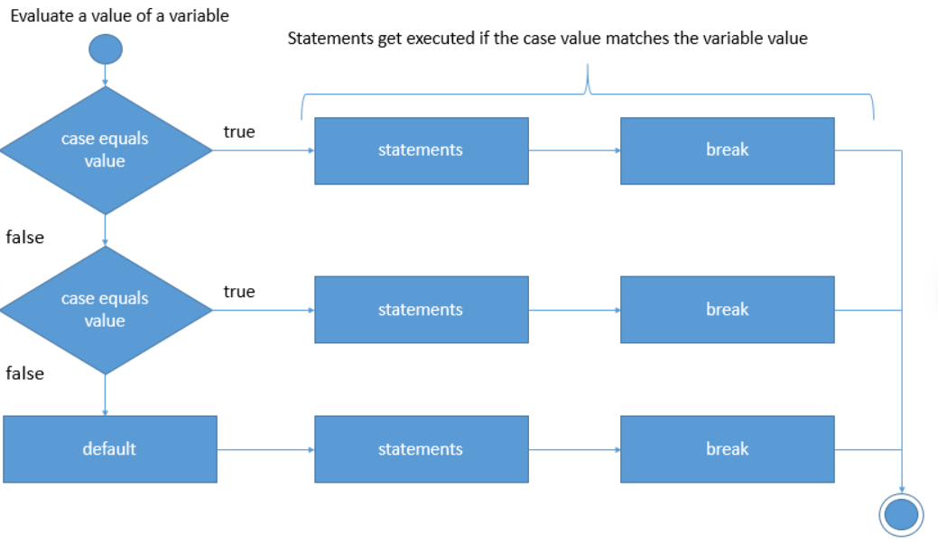
FLOW

Slide 139
EXAMPLE
The food item ordered gets displayed. If the ordered food is anything other than Burger, Pizza and Sandwich, then a message, 'Invalid selection' is displayed from default case.

Slide 140
CODE
public class Customer {
public static void main(String[] args) {
String orderedFood = "Pizza";
switch (orderedFood) {
case "Burger":
System.out.println("You have ordered Burger. Unit price: $10");
break;
case "Pizza":
System.out.println("You have ordered Pizza. Unit price: $15");
break;
case "Sandwich":
System.out.println("You have ordered Sandwich. Unit price: $8");
break;
default:
System.out.println("Invalid selection");
}
}
}

Slide 141
ITERATION CONTROL STRUCTURE WHILE
Iteration control structures are used to execute a set of statements repeatedly.
To terminate the repetition, a condition is required.

Slide 142
WHILE
when you want to repeatedly execute the statements as long as a condition is met, you can use the iteration control structure called while loop.
When the condition becomes false, the while loop terminates and control goes to the statement written after the while loop.
The while loop is used when the number of iterations are not known.
In case of while loop, the condition is tested before entering the while loop block and hence it is known as an entry-controlled loop.

Slide 143
SYNTAX
while (<condition>)
{
<statements>;
}

Slide 144
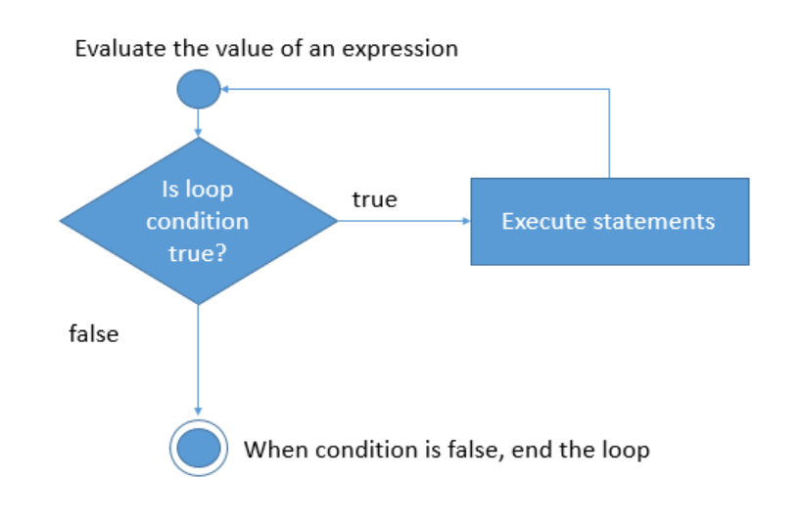
FLOW

Slide 145
EXAMPLE
Let us assume that an order should be placed for multiple food items and that the number of food items to be ordered is not known at the beginning. If the user wants to order an additional food item, the process of accepting the food item, quantity and calculation of the total amount is repeated whenever the order is placed.
In the below code, wantToAddFoodItem is initialized to 'Y'. The condition of while loop evaluates to true, so, the statements inside the loop get executed, i.e., the total cost of the order is calculated. The customer is then asked if he/she wants to add one more food item. If the customer provides the input as 'Y', then the condition evaluates to true and the statements inside the loop are executed again. If the input is 'N', the flow of control goes out of the loop.
Execute the below code in Eclipse and observe the output by providing the input. We have imported Scanner class to take the input from the customer. You will learn about import statement later in the course.

Slide 146
CODE
//Importing the Scanner class
import java.util.Scanner;
public class Customer {
public static void main(String[] args) {
// Create a Scanner object
Scanner sc = new Scanner(System.in);
int totalCost = 0;
char wantToAddFoodItem = 'Y';
int unitPrice = 10;
int quantity = 1;
while (wantToAddFoodItem == 'Y') {
totalCost = totalCost + (quantity * unitPrice);
System.out.println("Order placed successfully");
System.out.println("Total cost: " + totalCost);
System.out.println("Do you want to add more food items to your order? Y or N");
String input = sc.next(); // Accepting input from the customer
// Extracting first character from the input string
wantToAddFoodItem = input.charAt(0);
}}}

Slide 147
DO WHILE
When the loop has to be executed at least once before the condition is checked, do-while loop is used.
After the first execution, the loop then gets repeated as long as the condition is true.
In case of do-while loop, the condition is tested after executing the code block.
Hence, it is called an exit-controlled loop.

Slide 148
SYNTAX
do
{
<statements>;
} while (<condition>);

Slide 149
EXAMPLE
Observe the below code. The variable wantToAddFoodItem is initialized to 'N'. In this case, first the code block is executed and then the condition is tested. Hence, the cost is calculated first and then the condition is evaluated. When the condition is false, the loop terminates.

Slide 150
CODE
//Importing the Scanner class
import java.util.Scanner;
public class Customer {
public static void main(String[] args) {
Scanner sc = new Scanner(System.in); // Creating a Scanner object
int totalCost = 0;
char wantToAddFoodItem = 'N';
int unitPrice = 10;
int quantity = 1;
do {
totalCost = totalCost + (quantity * unitPrice);
System.out.println("Order placed successfully!");
System.out.println("Total cost: " + totalCost);
System.out.println("Do you want to add more food items to the order? Y or N");
String input = sc.next(); // Accepting input from the customer
// Extracting first character from the input string
wantToAddFoodItem = input.charAt(0);
} while (wantToAddFoodItem == 'Y');
System.out.println("Thank you for ordering the food! It will reach you shortly...");
}
}

Slide 151
FOR LOOP
The 'for' loop is used when the number of iterations are known.
for (<initialization>; <condition>; <increment/decrement>)
{
<statements>;
}

Slide 152
FOR LOOP
Initialization: It is used for initializing the variables used for checking the condition. It is executed only once and gets executed when the loop starts.
Condition: It is used for checking the condition to decide whether the loop should be terminated or executed. If the condition is true, the body of the loop is executed, else the loop terminates.
Increment / Decrement: It increments or decrements the value of the variable used for checking the condition after every iteration of the loop.

Slide 153
FOR LOOP
All the three parts of for loop are optional.
For instance, the for loop can also be written as for(;;) where none of the parts are provided.
This for loop will result in infinite loop.

Slide 154
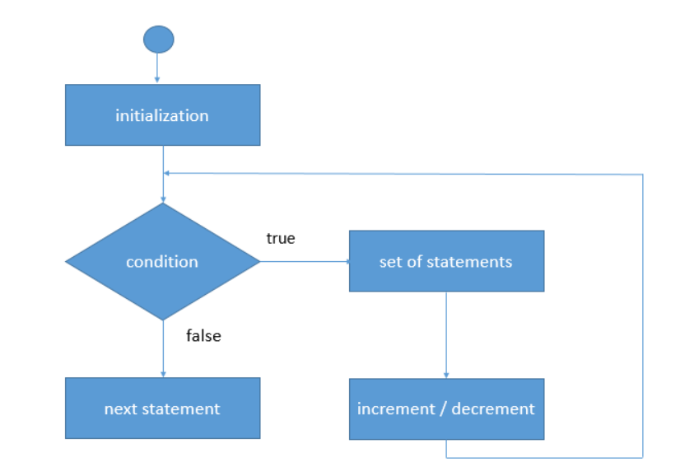
FLOW

Slide 155
EXAMPLE
Let us consider that the customer wants to place order for multiple food items and the number of food items to be ordered is already decided. In the code given below, we are assuming that the customer wants to order 3 food items.

Slide 156
CODE
//Importing the Scanner class
import java.util.Scanner;
public class Customer {
public static void main(String[] args) {
// Create a Scanner object
Scanner sc = new Scanner(System.in);
int totalCost = 0;
int unitPrice = 10;
System.out.println("Enter the number of food items to be ordered");
int noFoodItemsToBeOrdered = sc.nextInt();

Slide 157
CODE
for (int counter = 1; counter <= noFoodItemsToBeOrdered; counter++) {
System.out.println("Enter the food item");
String foodItem = sc.next();
System.out.println("Enter the quantity");
int quantity = sc.nextInt();
System.out.println("You have ordered: " + foodItem);
totalCost += unitPrice * quantity;
System.out.println("Order placed successfully!");
System.out.println("Total cost of the order: " + totalCost);
}}}

Slide 158
NESTED FOR LOOP
A nested loop is a loop within another loop, an inner loop within the body of an outer one.
Let us print the following pattern:
1 1 2 1 2 3 1 2 3 4 1 2 3 4 5 1 2 3 4 5 6 1 2 3 4 5 6 7 1 2 3 4 5 6 7 8 1 2 3 4 5 6 7 8 9 1 2 3 4 5 6 7 8 9 10

Slide 159
CODE
class Numbers {
public static void main(String[] args) {
int rows = 10;
for (int i = 1; i <= rows; ++i) {
for (int j = 1; j <= i; ++j) {
// print displays the text without adding a new line
System.out.print(j + " ");
}
System.out.println(""); // println displays the text along with a new line
}
}
}

Slide 160
BREAK
Break statement is used to terminate a loop.
After terminating the loop, the next statement following the loop gets executed.
In case of break statement written in nested loops, the inner most loop gets terminated and the flow of control continues with the statements of outer loop.
break statement is also used to terminate the execution of a switch case,

Slide 161
CONTINUE
Continue statement is used to skip the current iteration of a loop and continue with the next iteration.
In case of while and do-while loops, continue statement skips the remaining code of the loop and passes the control to check the loop condition.
Whereas in case of for loop, the control goes to the increment section and then the condition is checked.

Slide 162
BREAK VS CONTINUE
BREAK | CONTINUE
Terminates a loop or switch statement | Skip the remaining statement of the loop for the current iteration
Can be used in loops and switch. | Can be used within the loops

Slide 163
OOPS CONCEPT
Object Oriented Programming(OOP) is a type of programming approach which enables the programmers to work with real life entities like Customer, Trainee, Employee, Company, Product, Food, Book, etc.
Java, C#, Simula, JavaScript, Python, C++, Visual Basic .NET, Ruby, Scala, PHP etc. are some of the popular object-oriented programming languages.
OOP helps a programmer in breaking down the code into smaller modules. These modules (classes) will have state(represented by attributes/variables) and functionality (represented by behavior/methods).
These modules can then be used for representing the individual real life entities known as objects.

Slide 164
CLASS
A representation specifying the characteristics and behaviors of an object is called a class.
It is not a real life entity but a template for representing real life entities.
Blueprint/Template

Slide 165
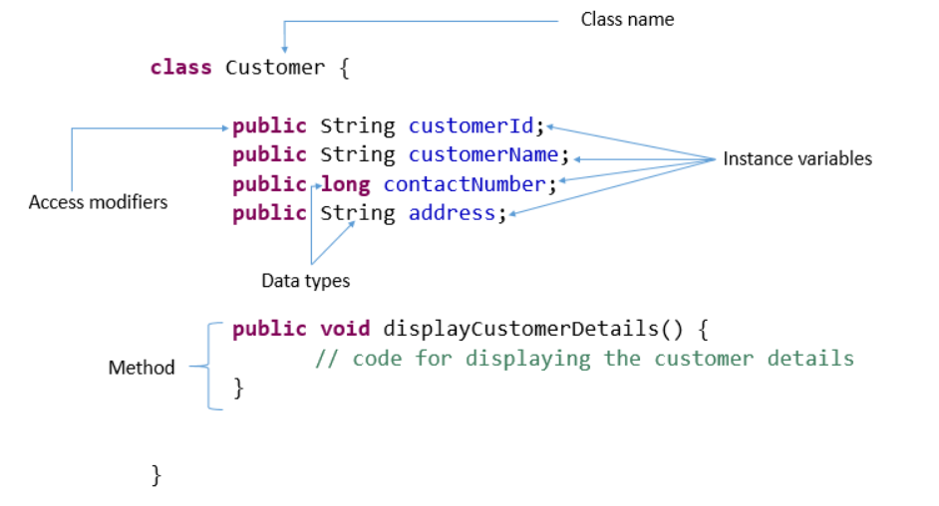
SYNTAX

Slide 166
OBJECT
An object, which is an instance of a class is a real life entity which has some attributes and behaviors.
The class determines the attributes and behaviors which an object should possess to belong to the class.

Slide 167
example
The requirements with respect to a customer are as follows:
Customers should have details like Id, name, contact number and address. Customers should also have functionalities to view their details, update their details, pay bills, etc.
There are three types of customers: Guest, Regular and Premium.
Guests are those who are not registered customers. They need to pay some delivery charge while ordering food.
Regular customers get some discount while ordering food.
Premium customers are special type of regular customers who get more discount as well as membership benefits. Membership benefits currently include a premium card which can be used for acquiring and redeeming points while ordering food online.

Slide 168
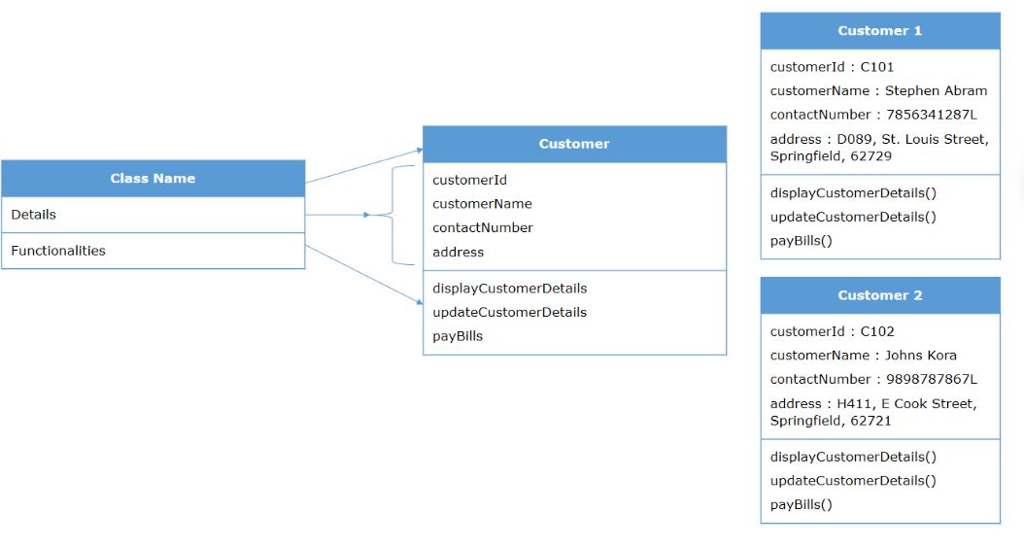
EXAMPLE

Slide 169
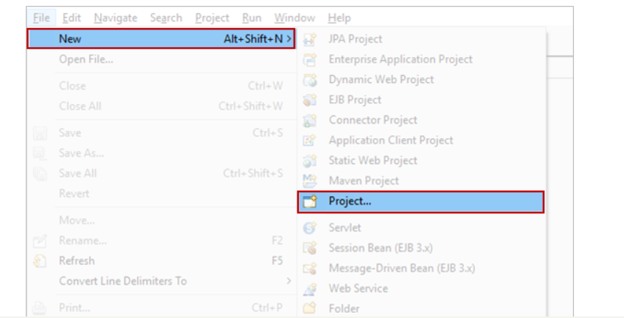
CREATING A CLASS
Let us now create the class for Customer.
Classes in Java are created using the keyword class followed by a name.
Step 1: Create a new Java project as shown below.

Slide 170
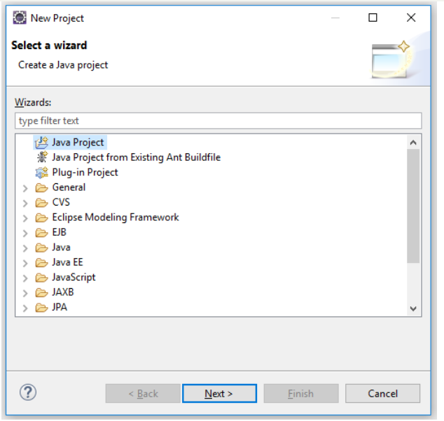
CREATING A CLASS

Slide 171
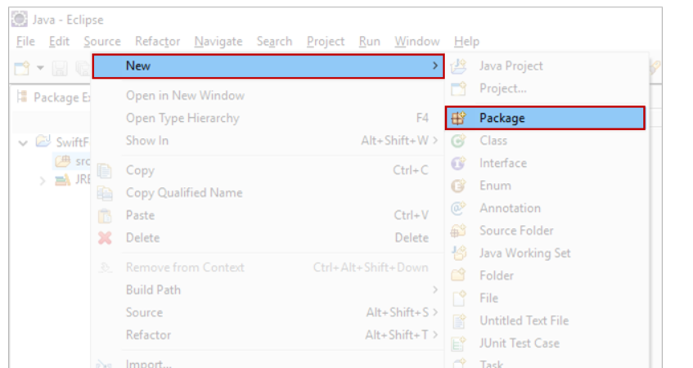
CREATING A CLASS
Step 2: Create a package named as shown below.

Slide 172
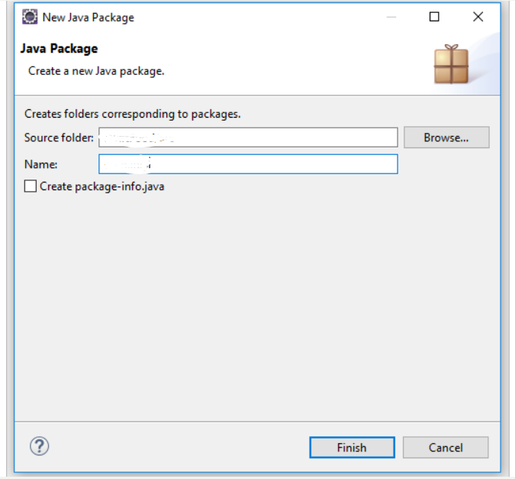
CREATING A CLASS

Slide 173
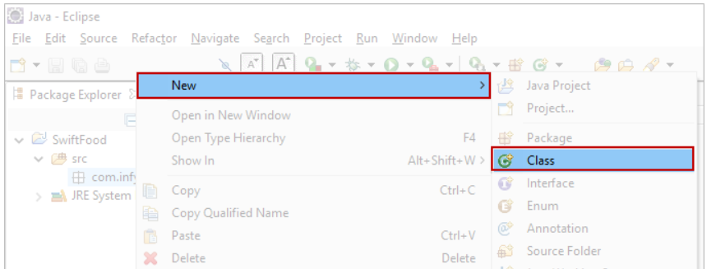
CREATING A CLASS
Step 3: Create a class by right clicking on the package and selecting New>Class.

Slide 174
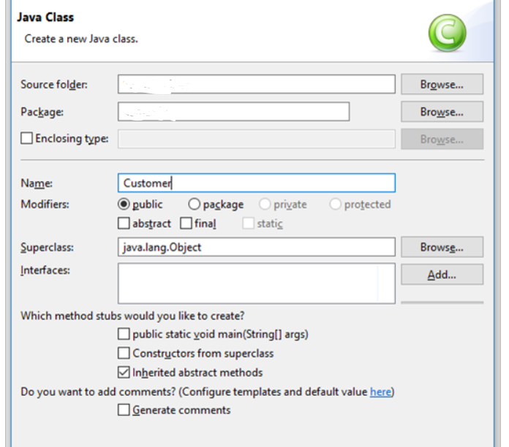
CREATING A CLASS
Enter the name of the class as Customer as shown below and give Finish

Slide 175
ATTRIBUTES
A class can have attributes (characteristics) and methods (behaviors)
Attributes are the elements or variables which hold the values or state of a particular entity.
class Customer {
public String customerId;
public String customerName;
public long contactNumber;
public String address;
}

Slide 176
ATTRIBUTES
CustomerId, customerName, contactNumber and address are the attributes of the class Customer.
Attributes are represented in classes by variables.
Attributes represent the state of a real life entity.
Each real life entity can have its own values for those variables. Since each instance of a class has different values for its variables, these variables are called instance variables.
Each instance variable has a data type associated with it. In the given code, String and long are the data types used.

Slide 177
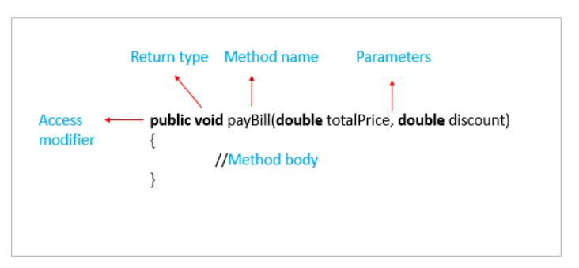
METHODS
Methods are the set of instructions which define the behaviors of the class.
It is used to implement a specific functionality. In Java, every method must be part of some class.

Slide 178
methods
Access modifier – defines the access type of the method. You will learn more about this later in the course.
Return type – the data type of the value returned by the method or void if nothing is returned
Method name – name of the method
Parameters – comma separated input values passed to the method, should be () if no parameters are passed
Method body – the code that defines the functionality of the method

Slide 179
EXAMPLE
class Customer {
public String customerId;
public String customerName;
public long contactNumber;
public String address;
public void displayCustomerDetails() {
System.out.println("Displaying customer details \n***********");
System.out.println("Customer Id : " + customerId);
System.out.println("Customer Name : " + customerName);
System.out.println("Contact Number : " + contactNumber);
System.out.println("Address : " + address);
System.out.println();
}}
displayCustomerDetails() is the method that represents a behavior of displaying details of the customer.

Slide 180
OBJECT CREATION
Once the class is ready, the next step is to create instances of the class which can represent real life entities. These instances are called as objects of the class.
An object is an instance of a class
An object holds data for every instance variable of a class
It allows us to use the instance variables and methods specified in the class
Any number of objects can be created for a class
In Java, an object of a class is created using the new keyword.

Slide 181
EXAMPLE(CONTD..,)
public static void main(String args[]) {
Customer customer = new Customer(); //Object Creation
customer.customerId = "C101";
customer.customerName = "Stephen Abram";
customer.contactNumber = 7856341287L;
customer.address = "D089, St. Louis Street, Springfield, 62729";
customer.displayCustomerDetails();
}

Slide 182
Contd..,
The new keyword is responsible for creation of the object and having memory allocated for it.
Variables referring to objects are called reference variables. In the above code, customer is a reference variable.
Instance variables are automatically initialized to the default value of the data type during object creation.
Once an object is created, the object's methods and attributes can be invoked using the "." operator depending upon the access modifier as shown above.

Slide 183
METHODS WITH PARAMETER
A method can accept data as arguments or parameters.
EXAMPLE:
public void payBill(double totalPrice, double discountPercentage) {
System.out.println("Calculating final amount to be paid......");
double priceAfterDiscount = totalPrice * (1 - (discountPercentage / 100));
System.out.println("Hi " + customerName
+ ", your final bill amount after discount is: "
+ (int) (priceAfterDiscount * 100) / 100.0);
}

Slide 184
METHODS WITH PARAMETER
The values for the arguments need to be passed while calling the method is as shown below in the code.
The arguments passed while making the method call are known as actual parameters and the arguments present in the method header are known as formal parameters.

Slide 185
METHODS WITH PARAMETER
public static void main(String args[]) {
Customer customer = new Customer();
customer.customerId = "C101";
customer.customerName = "Stephen Abram";
customer.contactNumber = 7856341287L;
customer.address = "D089, St. Louis Street, Springfield, 62729";
customer.displayCustomerDetails();
customer.payBill(500, 10);
}

Slide 186
RETURNING VALUE FROM A METHOD
The result of a method can be given back by means of a return value by using return statement as shown in the below method.
A method can return only one value at any point of time.
The datatype of the return value must match the return type mentioned in the method header. If the method does not return any value, void should be mentioned as the return type in the method header.

Slide 187
EXAMPLE
public double payBill(double totalPrice, double discountPercentage)
{
System.out.println("Calculating final amount to be paid.....");
double priceAfterDiscount = totalPrice * (1 - (discountPercentage / 100));
return priceAfterDiscount;
}

Slide 188
METHOD OVERLOADING
When a class has two or more methods with the same name but different parameters, the respective method is called based on the arguments passed.
The respective method body is dynamically bound to the calling line.
This mechanism is known as method overloading.

Slide 189
EXAMPLE
public class Sample {
public static void add(int a, int b) {
System.out.println(a+b);
}
public static void add(int a, int b, int c) {
System.out.println(a+b+c);
}
public static void main(String args[]) {
Sample obj = new Sample();
obj.add(20, 40);
obj.add(40, 50, 60);
}
}

Slide 190
Method Overriding in Java
In method overriding, the super class and subclass have methods with the same name, including parameters.
JVM calls the respective method based on the object used to call the method.
In overriding, the return types should also be the same.

Slide 191
EXAMPLE
class SuperClass {
public static void sample() {
System.out.println("Method of the super class");
}
}
public class SubClass extends SuperClass {
public static void sample() {
System.out.println("Method of the sub class");
}
public static void main(String args[]) {
SuperClass obj1 = new SubClass();
SubClass obj2 = new SubClass();
obj1.sample();
obj2.sample();
}
}

